Slide 1

The Evolution of Wireless Networks
The Evolution of Cellular and Wireless Networks
Video 2.2

Slide 2
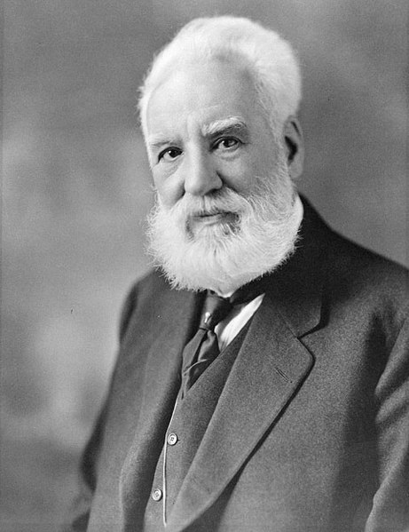

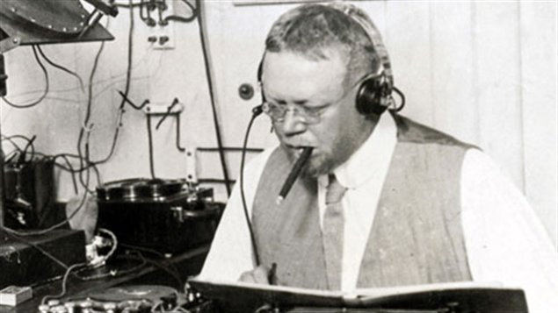
Beginning of Radio Telephony
US inventor Alexander Graham Bell invents the first telephone in 1875 or 1876.
Canadian inventor Reginald Fessenden becomes the first person to send audio over radio in 1906.
Alexander Graham Bell
Reginald Fessenden
Notes:
Photo Links:
Alexander Graham Bell – Wikimedia Commons https://commons.wikimedia.org/wiki/File:Alexander_Graham_Bell.jpg
Telephone pole and wires - https://pixy.org/5760701/
Reginald Fessenden – Wikimedia Commons https://commons.wikimedia.org/wiki/File:Reginald_Fessenden,_probably_1906.jpg

Slide 3
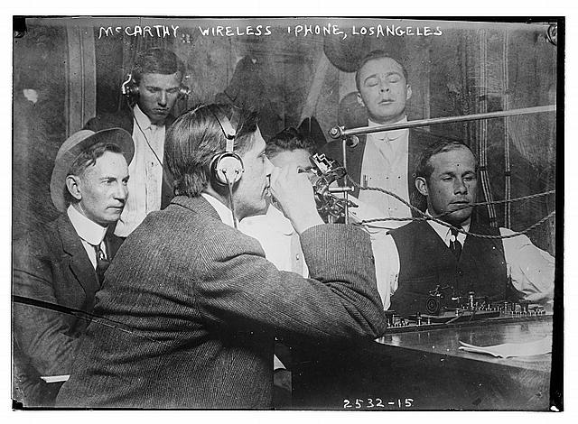

0G – Early Days
Radiotelephony became a focus for wireless voice communication.
1949: AT&T launched Mobile Telephone Service (MTS) in the US.
1965: Improved MTS (IMTS) was introduced with smaller equipment and 40,000 users.
Notes:
Photo Links:
Photo 1 from US Library of Congress: https://www.loc.gov/pictures/item/2014691130/, rights at https://www.loc.gov/rr/print/res/274_bain.html.
Phot 2 from Free Library of Philadelphia: https://libwww.freelibrary.org/digital/item/21114

Slide 4
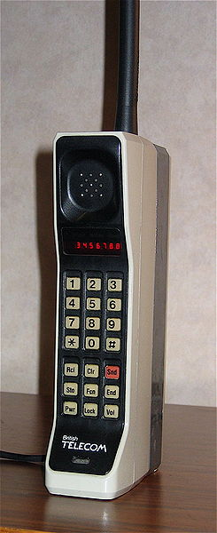
1G – 1980s
Japan was first to deploy analog cellular network in 1979 followed by European countries in 1981.
Advanced Mobile Phone System (AMPS) launched in the US in 1983.
1990: Digital AMPS (D-AMPS) was deployed in the US.
DynaTAC 8000X
Notes:
Photo Links:
Photo: https://commons.wikimedia.org/wiki/File:DynaTAC8000X.jpg

Slide 5

2G – 1990s
Increasing demand for voice and limited data drove network deployments.
Competing standards – GSM and CDMA.
Short Message Service (SMS) launched.
Notes:
Photo Links:
Photo: https://pixabay.com/photos/driving-cellular-by-typing-sms-844132/

Slide 6

3G – 2003
Record growth in demand for both voice and data.
Apple iPhone drove much of this growth.
Over 295 million 3G network subscribers by 2007.
Notes:
Photo Links:
Photo: https://pixabay.com/photos/iphone-smartphone-apps-apple-inc-410324/

Slide 7
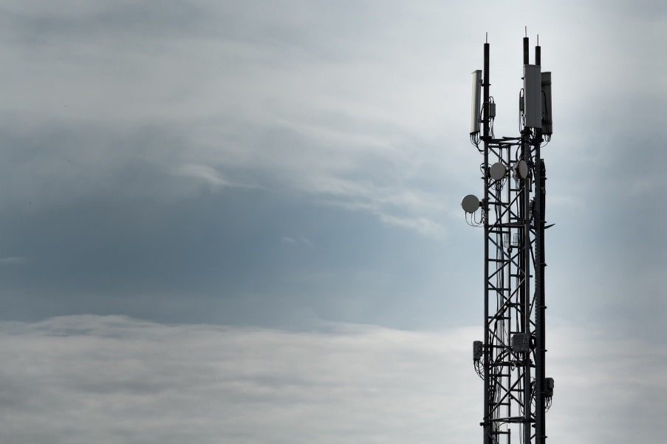
4G – 2013
Mobile access to the Internet became a reality.
4G evolved further with 4G Long Term Evolution (LTE).
2018: Over 5 billion cell phone users globally representing $6 trillion dollars in economic value.
Notes:
Photo Links:
Photo: https://pixabay.com/photos/mobile-radio-transmitters-handynetz-1159760/

Slide 8
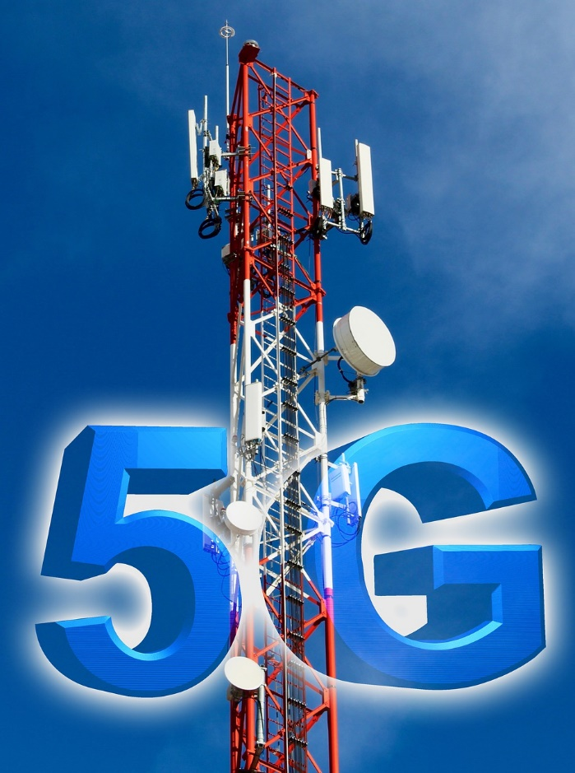
5G – 2019
5G networks deployed to support forthcoming 4th Industrial Revolution.
Estimates are $326 billion investment by 2025.
5G and 4G will co-exist for a number of years.
Notes:
Photo Links:
Photo: https://pixabay.com/photos/the-internet-5g-technology-free-4885743/#comments

Slide 9

6G – 2030?
Standards and specifications not defined.
Currently in research and development phase.
Japan, China, and European countries are doing initial trials.
Potential of 8,000 Gbps operating in 100 GHz to 10 THz frequencies.
Notes:
Photo Links:
Photo: https://pixabay.com/photos/earth-internet-globalisation-2254769/

Slide 10
Comparison
Generation | Maximum Download Speed | Typical Download Speed
2G | 100 to 300 Kbps | <100 to 100 Kbps
3G | 0.3 to 42 Mbps | 0.1 to 8 Mbps
4G | 150 to 979 Mbps | 15 to 90 Mbps
5G | 1 to 10 Gbps | 150 to 200 Mbps
6G* | 8 Tbps | Unknown
*Not defined nor deployed; this is estimated data download speed.
Notes:
Source: https://kenstechtips.com/index.php/download-speeds-2g-3g-and-4g-actual-meaning, https://www.digitaltrends.com/mobile/what-is-6g/

Slide 11
Architecture Changes in Wireless Networks
Next Video

